Slide 1
Team Lead 1 Presentation
Holly, James, Jon, and Ethan

Slide 2
Presentation Overview
Using GitHub
Setting up a new GitHub Repository
Cloning a Repository
Pulling a Repository
Commiting Changes
Pushing Commits
Software Analysis Presentation Requirements
— composed of group and individual marks
Team Introduction
Storyboard Slides
Global Use Case and Data Passing
Context Diagram
Diagram 0
RFP
Individual Aspect of the SA Presentation
Use Case Diagrams & Scenario
Data Flow Diagram
Data Flow Process
Test Plan
Champion Document
Presentation Marking Key Sheet

Slide 3
Using GitHub
First: setting up. Then: usage.

Slide 4
Setting up a new GitHub Repository
Download and install GitHub Desktop, and sign in or create account.
There are two main ways you can create a repository:
Create it online, and clone that Remote Repository to your computer.
Create it on your computer and push that Local Repository to the web.
While creating your repo, there are several important options to take note of:
Name/Description: choose an appropriate name and description for your repository.
Privacy: In our case the repositories are set up with the Public option so that all group members can add code.
README/.gitignore/license: for the purposes of this project we don’t need to worry about the README or license (they can also be added later), but we do have a purpose for a .gitignore file. For this project, the Unity .gitignore Template will be used, as it will help keep our pushes and pulls small.

Slide 5
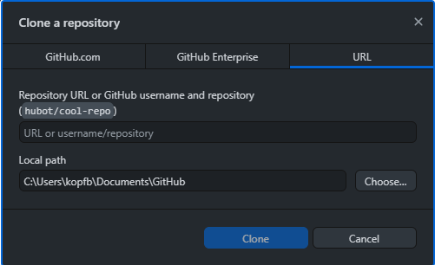
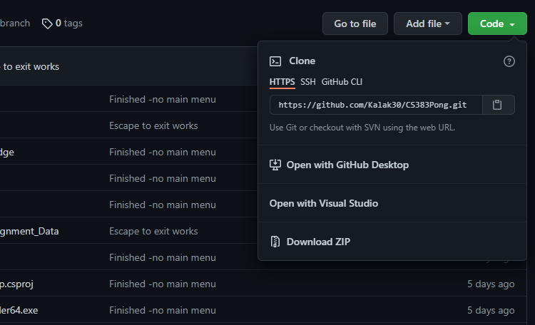
Cloning a Repository
GitHub Desktop
A Remote Repository can be cloned onto a local device, creating a Local Repository
To clone a repository from GitHub Desktop:
File -> Clone Repository (Ctrl+Shift+O)
Paste link to repo, click Clone
To clone a repository from GitHub Website:
Navigate to Remote Repository site.
Under Code dropdown, click “Open with GitHub Desktop”
GitHub Website

Slide 6
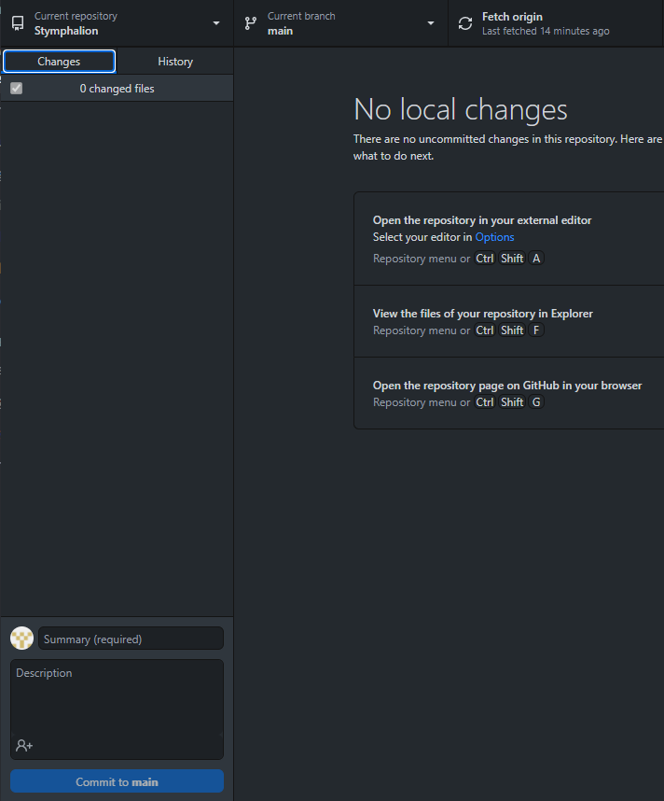
Pulling a Repository
A Pull syncs your local repository and the remote repository by adding changes made in the remote repository to your local repository. This will allow you to stay up to date with your project.
On the GitHub desktop app, you can fetch the most recent updates, and pull them into your repo, by pressing the Fetch origin button in the top ribbon.

Slide 7
Committing Changes
A commit is a collection of saved changes to a local repository. Every commit has an associated commit message. The message explains why a particular set of changes was made. In the message, you should explain the reason/purpose of your commit.
Make some changes to your repository (edit some code, add a file, etc). As changes are made, they will appear on the left hand side of GitHub Desktop. Press Ctrl+1 to make the changes list visible.
At the bottom of the Changes panel, add a summary of changes made and a description of their purpose.
Then press the blue Commit to main button to save your changes locally.
To save the changes to your local repository, they will need to be pushed to the remote repository.

Slide 8
Pushing Commits
A push in git is the action of cloning commits, saved changes, from your local repository to a remote repository. This is how you will keep the remote repository up to date.
Once you have one or more commits that you would like to confirm, you are ready to push those commits to the remote repository.
To push your commits, press the Push origin button on the top ribbon. Make sure the repository you are pushing to is the repository for your game. You can also use the Push shortcut Ctrl+P.

Slide 9
Software Analysis Presentation Requirements
September 23rd

Slide 10
This presentation will be a combination of group marks and individual marks
Group Marks:
Presentation Slides and Presentation requirements
Global use case walkthrough and data passing
Context Diagram and Sample Screen shots
Diagram 0- total project breakdown
RFP
Storyboard
Individual Marks:
Reintroduce yourself and your feature
The details of your feature and its overall role in the project
Give priority of your feature and its complexity
Use case diagram & scenario
Data flow diagram
Test plan (rough)
Champion document (Following Friday)

Slide 11
Team Introduction
Your slides for this presentation will be due the Tuesday before you present
Introduction your:
Team name and group members
Name of your game
Goal of the game
Story of the game

Slide 12
Storyboard Slides
Use the storyboard slides to describe the story of your game. We will be giving you an example of a storyboard later on
Your completed storyboard will have:
Seven or more completed frames
Each Frame has pictures and written information to explain the frame
The story frames flow and make sense in chronological order
There should be a main character (player as you navigate the game) with description
The clear goal for the mission
Story is written in complete sentences and paragraphs, with correct grammar, and conveys the story

Slide 13
Global Use Case and Data Passing
The Global Use Case is for the game as a whole. It will be how your whole team’s features work together.
It should include:
The actor that initiates the event
The event that triggers a use case
The use case that performs the action triggered by the event
Data Passing:
What functions will be required and what data will be passed to each function
Initiates
Begins
SERIES OF INTERACTION IN SYSTEM
ACTOR
EVENT

Slide 14
Use Case Con’t
Define the use case only once but can be referenced by several diagram
Naming of a use case: A verb and a Noun
Association
Use Case Symbol

Slide 15
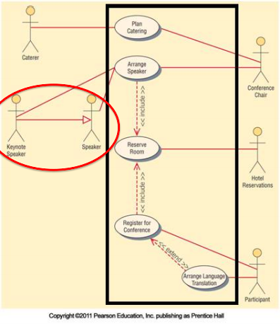
Complete example of system used to plan a conference (From Dr. BC presentation)

Slide 16
Global Use Case Walkthrough Example
Global Use Case is how all the parts of your project work together. A good place to start might be with your main function and what/whos functions it may call.
How did those function interact with other functions and what did the function do
Explain the levels and how different actions cause a variety of events to unfold. For example, the initLevel(int) function starts playing the theme song
Go through the calls that are made, are there different arrays that are filled? Are there loops that run?

Slide 17
Context Diagram
This Context Diagram will help summarize all activity in the system and subsystems
Context Diagrams contain:
Highest view of the system
Shows system boundaries and scope
Context Diagrams do not include:
Data stores
Details within the system

Slide 18
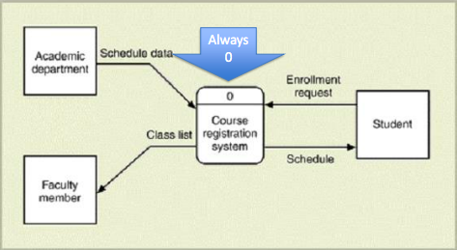
Context Diagram example for Course Registration System (Dr. BC)

Slide 19
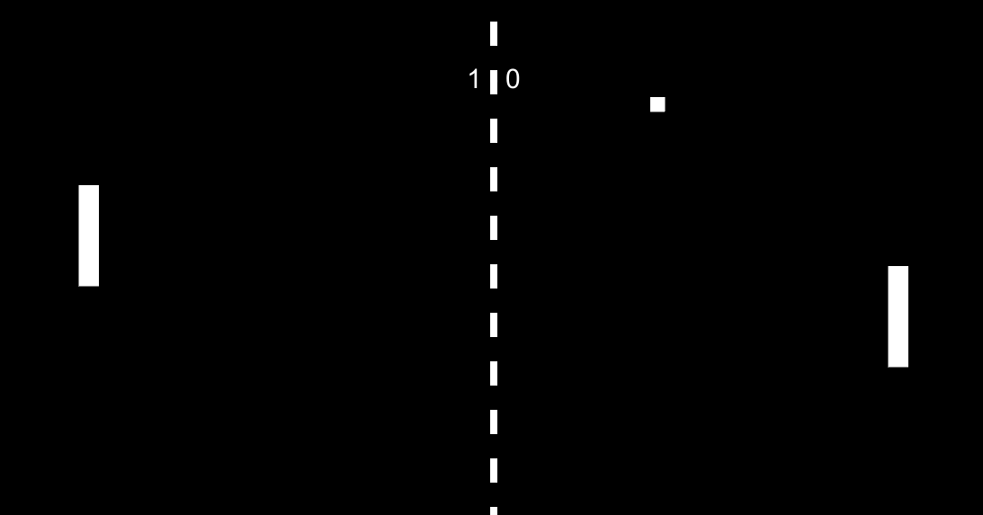
Sample Screenshots
Include several sample screenshot of your game running.

Slide 20
Diagram 0
Analyze the major activities in the context process.
Include external entities and major data stores.
For complex processes include a child diagram with local data stores and details.
Check for errors

Slide 21
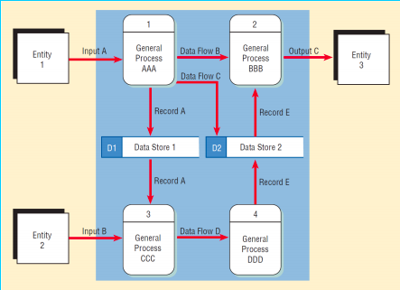
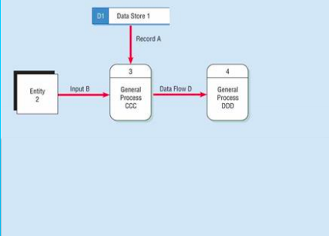
Diagram 0
Child Diagram

Slide 22
RFP
Due Thursday September 23rd 2021
Should include:
Proper title page
Table of contents
Problem description and project objectives
Intended users and interactions
Known constraints
Project Schedule and dates
Proposals
Glossary of terms

Slide 23
Individual Aspect of the SA Presentation
Re-introduce yourself and the feature of your game
Provide details of that feature and the overall role it has to the project
Explain the priority, importance, and complexity of the feature
**You will have individual slides that go with your feature and you will be the one required to talk about it. This aspect of the presentation is marked individually for each person

Slide 24
Use Case Diagrams & Scenario
These use case diagram(s) will be similar to the global use case done for the whole game, but will the specific for your feature.
Fewer use cases the better (but required one for each person)
Remember: an actor initiates an event that begins an event in the system
Scenario of how the aspect of your game will unfold

Slide 25
Data Flow Diagram
You will take the context diagram that reports the needs based on the solution, but will add the “Data Process” to include where the data came from, how it is transformed to produce the report and where it is being stored
Data Flow diagrams can be difficult as they report on many different layers.

Slide 26
Data Flow Process
Create a logical data flow diagram of current system
Add the data and processes in the new system, this will be the updated logical DFD of the new system
Derive the physical DFD for the new system from the created logical one

Slide 27
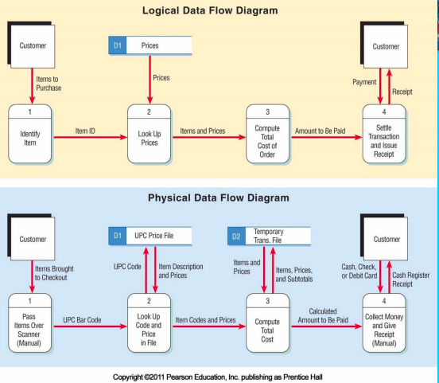
Logical and Physical Data Flow Diagrams (Dr. BC presentation)

Slide 28
Test Plan
You will be required to address what sort of planning you will be doing to ensure your aspect of the game is functioning
This will just be a rough plan

Slide 29
Champion Document
Due on Friday
The document will include:
Brief Introduction
Use case diagrams
Scenario
At least one exception case (with extend)
<<include>> suitable for dynamic binding
Data Flow diagram from level 0 with feature description
Acceptance Tests
Timeline that works with pert diagram and gantt chart

Slide 30
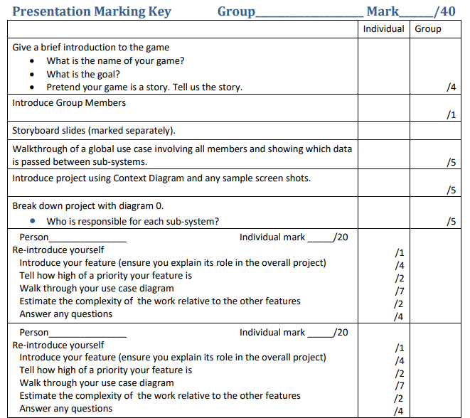
Presentation Marking Key Sheet

Slide 31
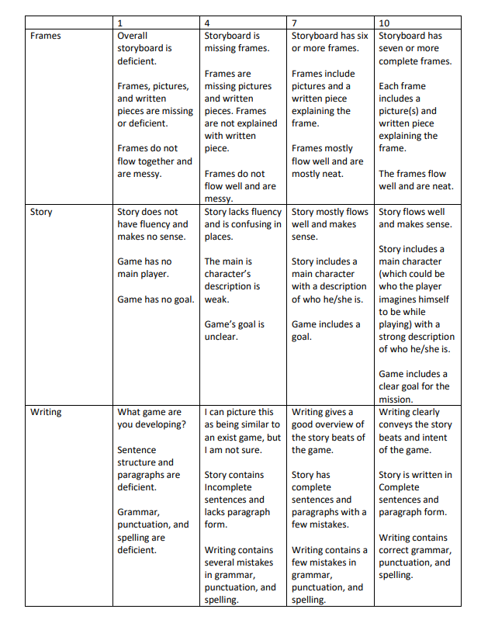
Storyboard Presentation Key

Slide 32
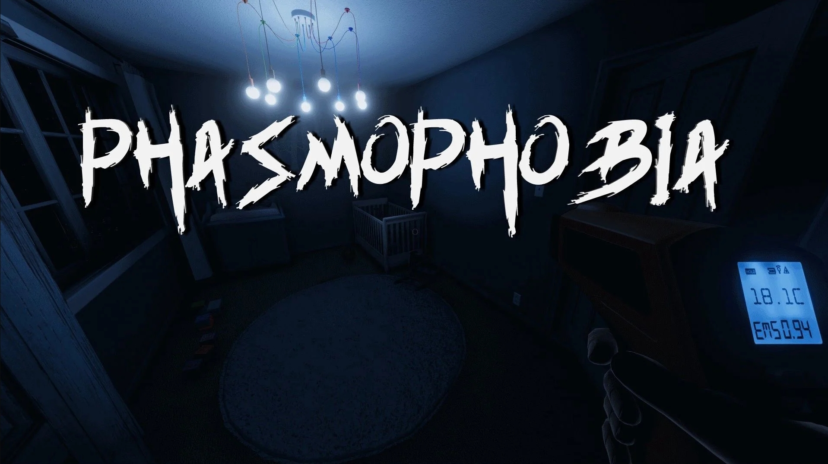
Phasmophobia is a 4 player online co-op psychological horror game. Paranormal activity is on the rise and it’s up to you and your team to use all the ghost hunting equipment at your disposal in order to gather as much evidence as you can.

Slide 33
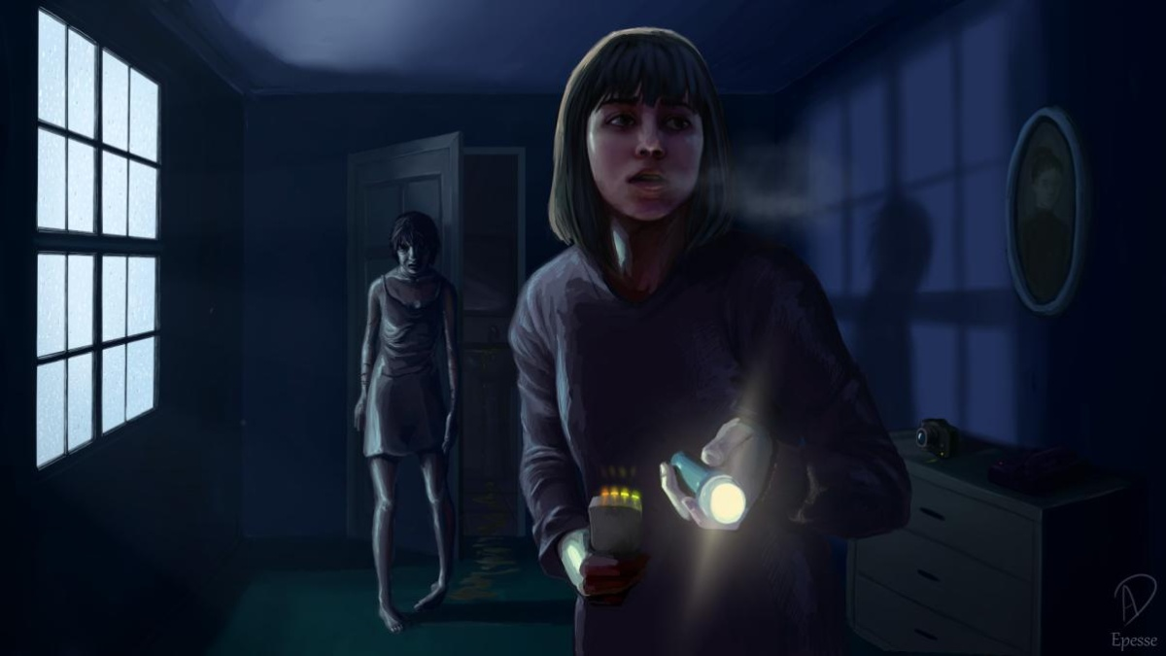
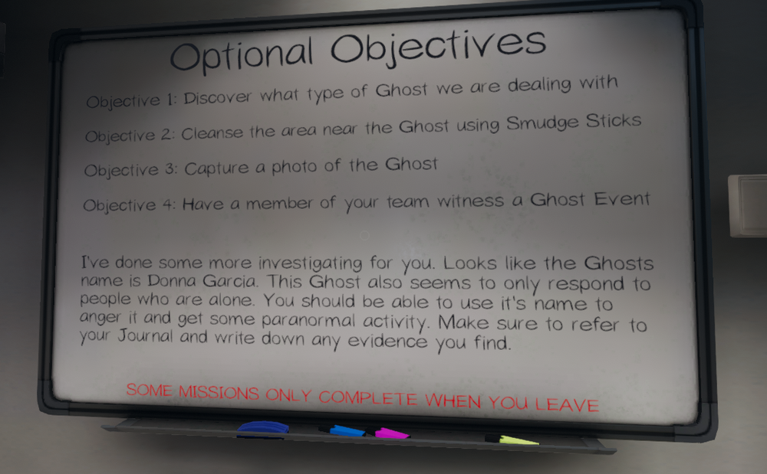
You play as an investigator. The main goal of the game is to complete contracts, which primarily means to determine what kind of ghost is haunting a location while completing some optional objectives that are determined randomly upon arrival. Completing objectives increases the amount of payment after each mission which allows you to buy better ghost hunting equipment.

Slide 34
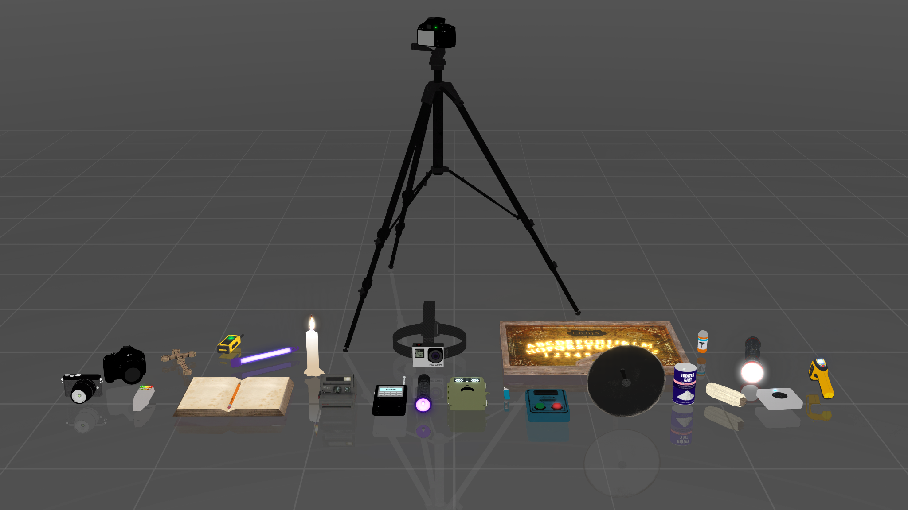
You will have many different tools at your disposal during the course of your ghost hunting career. Each tool is used to confirm different ghost traits which will narrow down the type of ghost in the location.

Slide 35
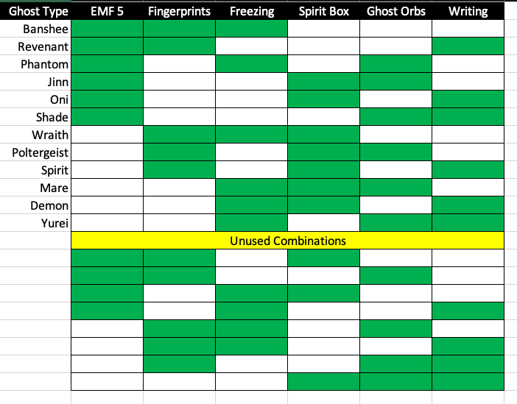
The type of ghost is determined by what evidence you gather on your mission. Three types of evidence will be needed to confirm the ghost type. At this time we have 12 ghost types. Using this method of evidence we can expand to include more ghost types in the future.

Slide 36
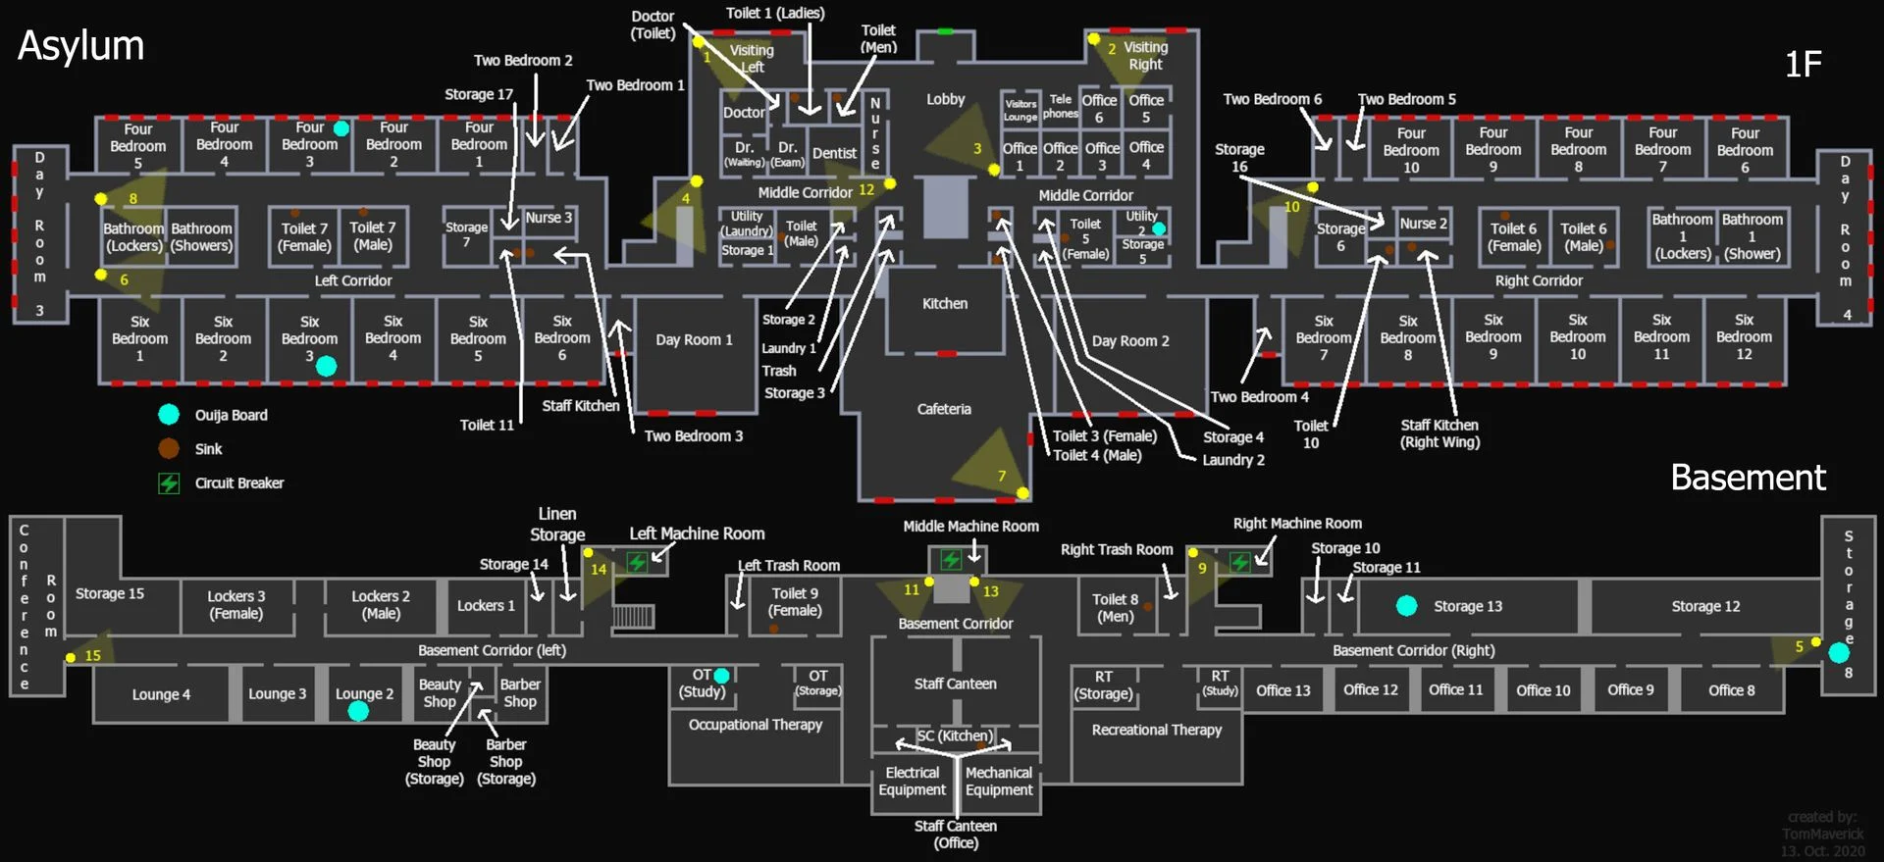
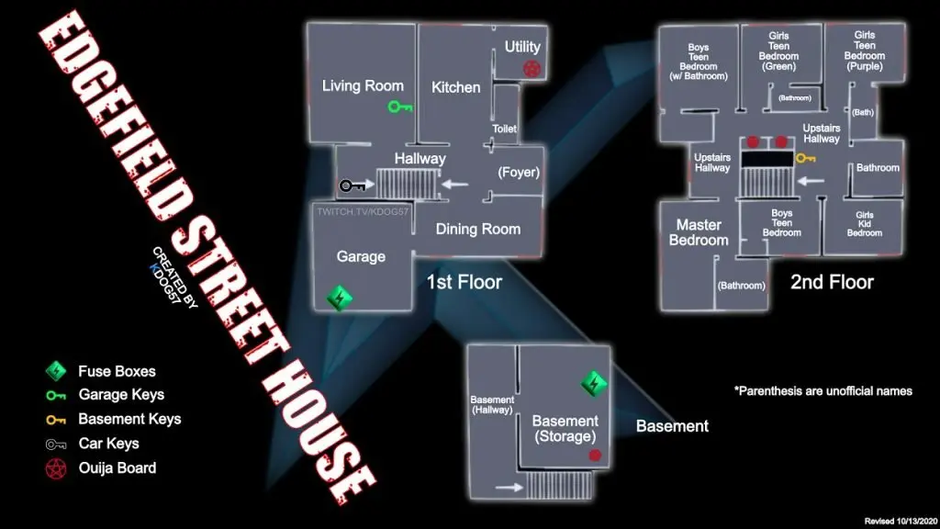
You will visit many locations during your career. Some as complex as an Asylum or more common locations like the Edgefield Street House. Multiple locations to visit gives a variety of gameplay options.

Slide 37
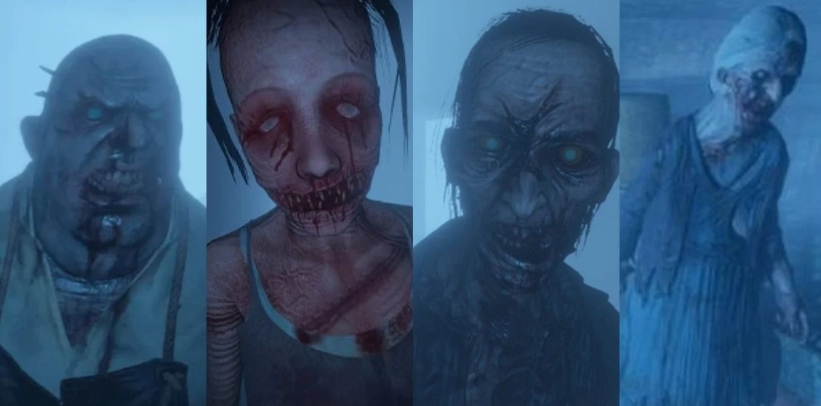
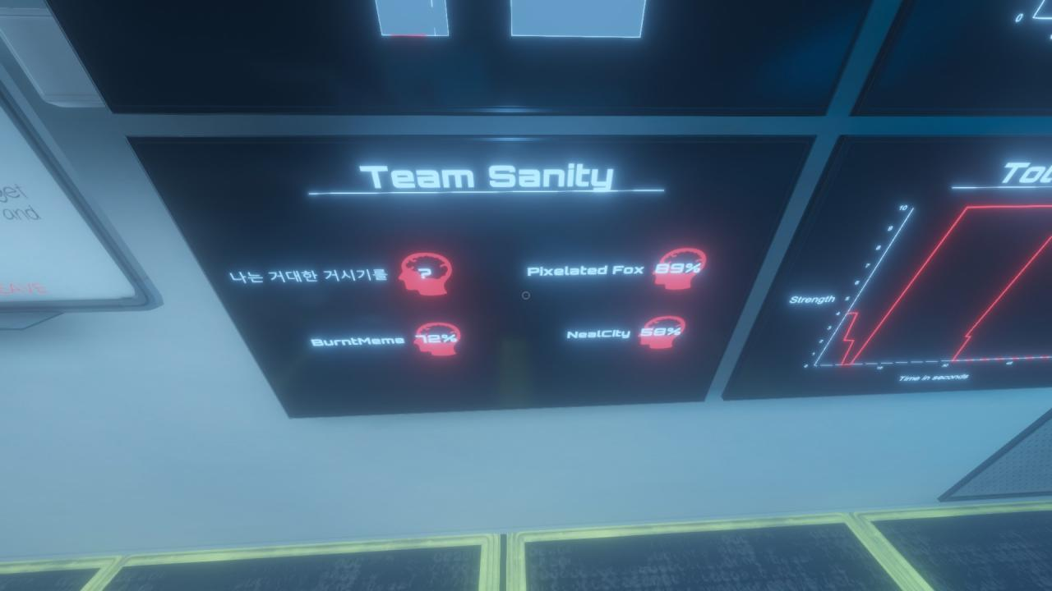
Ghost hunting isn’t for the faint of heart, or mind. You are going to need to keep a close eye on your Sanity. Coming into contact with any members of this handsome lineup will cause your sanity to drop. The lower your sanity, the more active the ghosts will become, hunting you..

Slide 38
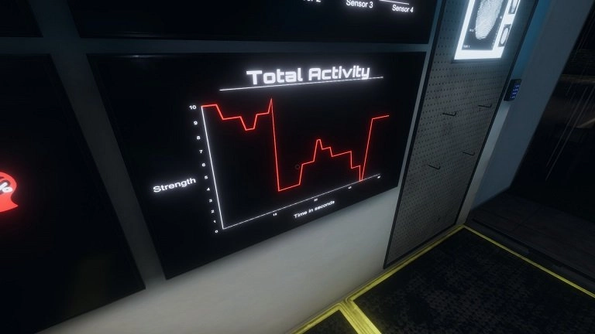
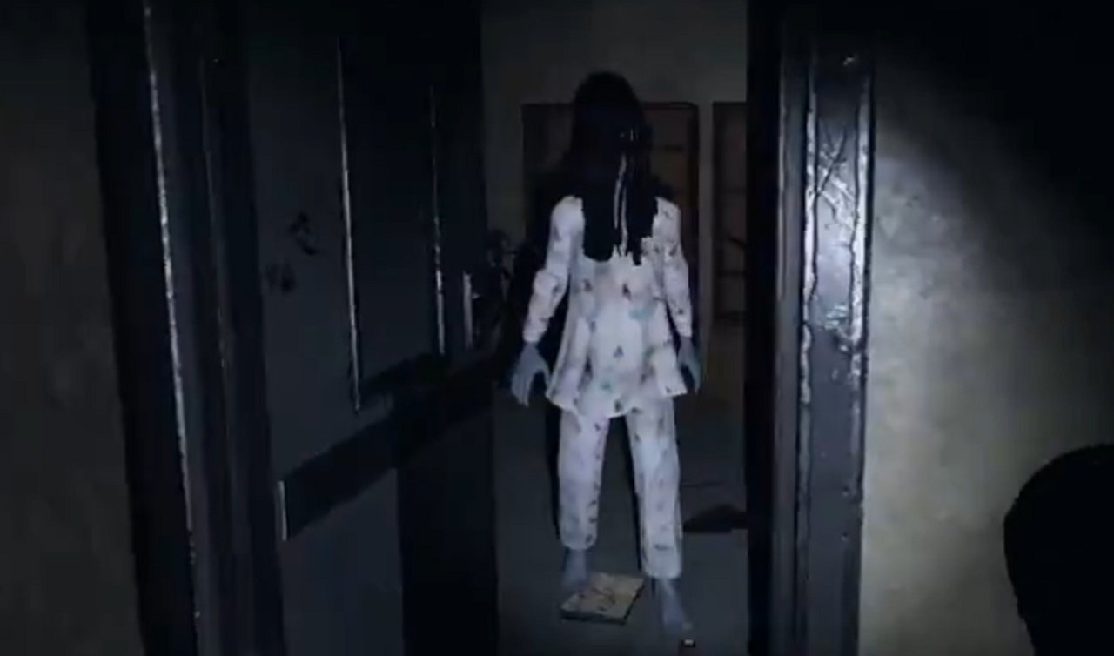
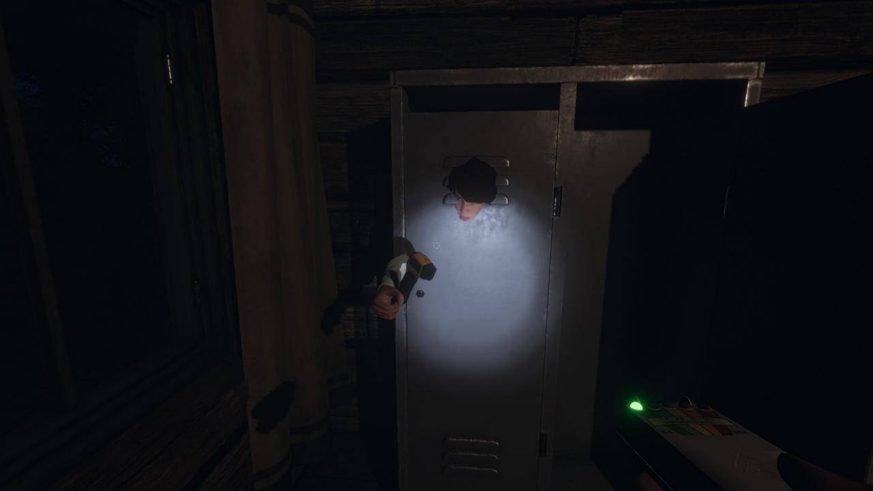
During times of peak Activity the ghost will hunt you down. This is a great time to find a locker or closet to hide in until it’s safe. Failure to hide could result in death.

Slide 39
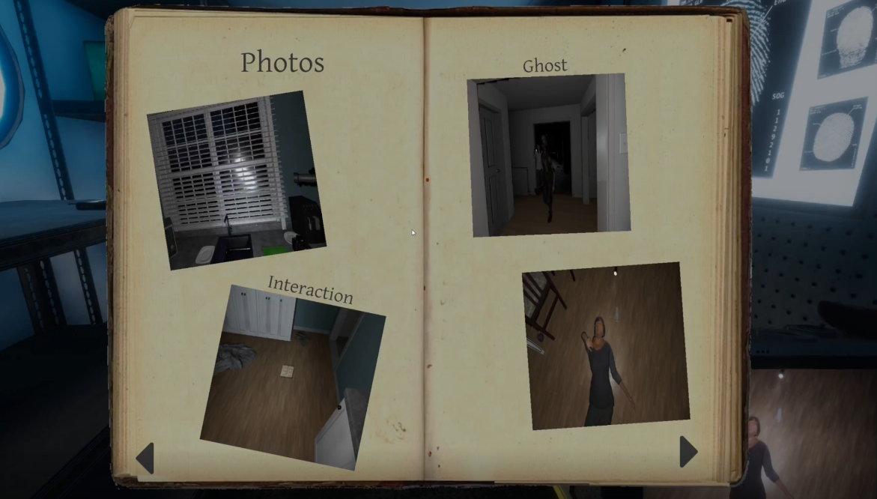
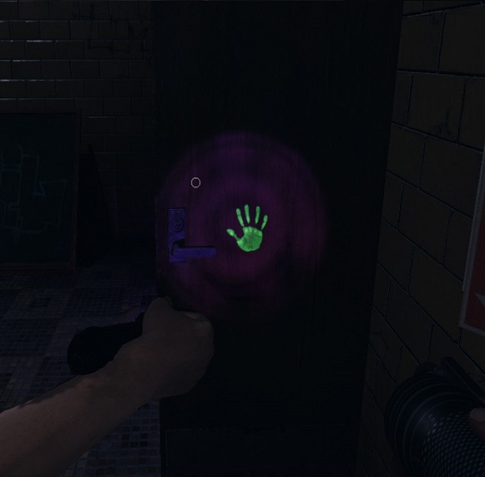
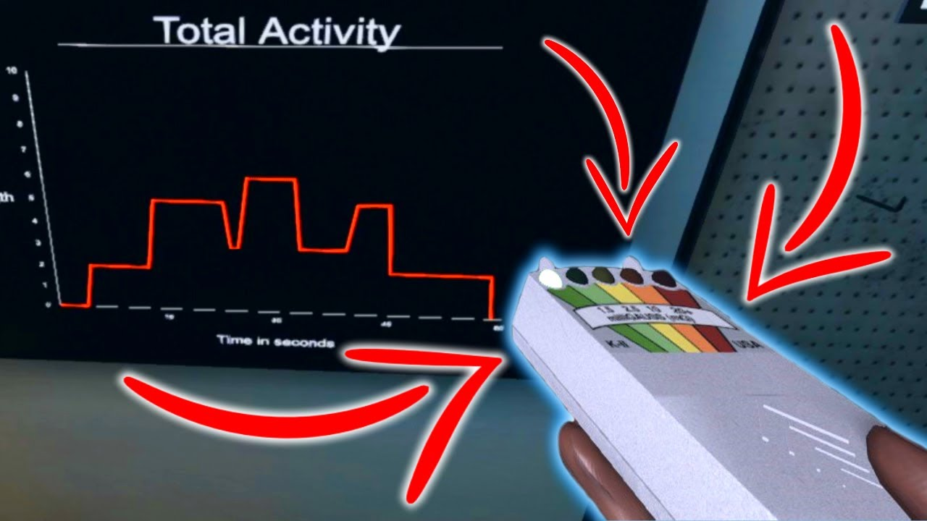
In conclusion. Take pictures, hunt ghosts, gather evidence, run, hide, be hunted, get paid. And remember, keep calm and carry a big candle.

